Slide 1
National Institute of Food and Agriculture – USDA Catalyzing Partnerships in Renewable Aviation Fuel Production Systems
CAAFI Biennial General Meeting January 29, 2014
Bill Goldner, Ph.D.
wgoldner@nifa.usda.gov

Slide 2
National Institute of Food and Agriculture Sustainable Bioenergy
Facilitate system-based approaches for development of sustainable supply chains for the production of biofuels, biopower, and bioproducts.
>$140 M NIFA current five year investment in renewable aviation fuel supply chains.
Agriculture and Food Research Initiative: $112 M
(four projects)
Biomass Research and Development Initiative: $20 M
(three projects)
Non-competitive: ~$6 M

Slide 3
Regional Approaches to Bioenergy Systems
Coordinated Agricultural Projects (CAP)
Regional partnerships
Academic, industry, government, non-government,
Work back from targets to develop entire supply chains
Build on existing infrastructure and previous investments
Integrate Research, Education, and Extension/Tech Transfer
Robust sustainability analysis: Impacts on …
Economics, rural communities, and the environment
Targeted Feedstocks (perennial grasses, energy cane, sorghum, woody biomass, oil crops)
2010-2013: 7 AFRI awards totaling ~$156 M over 5 years

Slide 4
Softwood Residues *
Switchgrass MiscanthusWillow
Switchgrass
Purpose-grown Hardwoods *
Insect-damaged Trees
Switchgrass Eucalyptus Pine *
Energy Cane Sorghum*
* = aviation fuel target

Slide 5
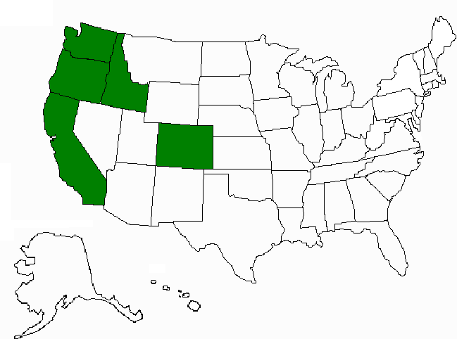
System for Advanced Biofuels Production from Woody Biomass In the Pacific Northwest
PD: R Gustafson, U Washington, $40,000,000 (5 years)
27 Key Personnel from 5 Universities, a Community College Consortium, and 2 Industrial Partners from 5 States:
Biogasoline, renewable aviation fuel
Purpose-grown poplar
GreenWood Resources
Bioconversion and fuel production
ZeaChem

Slide 6
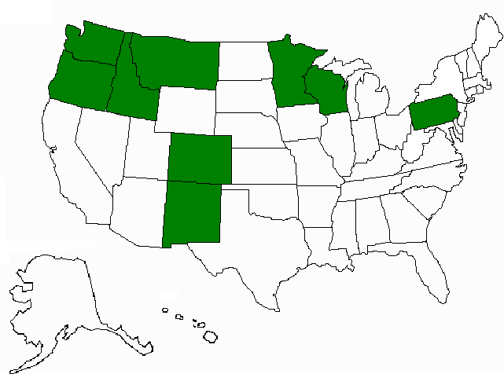
Northwest Advanced Renewables Alliance (NARA): New Vista for Green Fuels, Chemicals, and Products
PD: R Cavalieri, WA St U, $40,000,000 (5 years)
41 Key Personnel representing 9 Universities, 3 Federal Partners, and 6 Industrial Partners from 9 States:
Renewable aviation fuel, value-added industrial chemicals
Woody biomass residues
Weyerhaeuser, other land owners
Bioconversion and fuel production
Gevo, Catchlight
Boeing is on advisory board

Slide 7
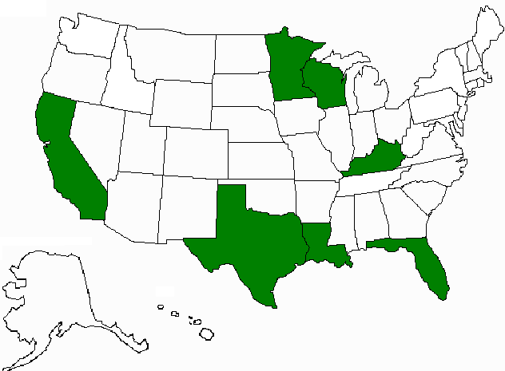
A Regional Program for Production of Multiple Agricultural Feedstocks And Processing to Biofuels and Biobased Chemicals
PD: D Day, LA St U, $17,300,000 (5 years)
37 Total Key Personnel from 5 Universities, 1 Federal Partner, and 7 Industry Partners in 7 States:
Biobutanol, gasoline, aviation fuel and industrial chemicals
Energy cane (ARS, SRU) and sweet sorghum (Ceres)
Logistics (John Deere)
Bioconversion to sugars,
fuel and chemical production
Virent, DuPont/Genencor, Optinol,
MS Processes, Intl.

